Slide 1

EXCEL ENGINEERING COLLEGE
ARTIFICIAL INTELLIGENCE AND DATA SCIENCE
MAJOR PROJECT
Social Media Sentiment analysis using NLP
STUDENTS NAME:
ATIULLAH ANSARI (730920201009)
BHUPENDRA KUMAR (730920201011)
KANNU PRIYA (730920201020)
SONU KUAMR (730920201048)
PROJECT GUIDE
Dr. P . SELVARAJU
AP/AI&DS

Slide 2
OUTLINE
INTRODUCTION
OBJECTIVES
METHODOLOGY
PROPOSED WORK
LITERATURE SURVEY
FLOWCHART
SOFTWARE
Datasets Collection
Data Cleaning
Graphical Representation
Conclusion
References

Slide 3
TRODUCTION
INTRODUCTION
Social media sentiment analysis refers to the process of analyzing and understanding the sentiment expressed in social media content. It involves applying natural language processing (NLP) and machine learning techniques to automatically determine whether social media posts, comments, reviews, or other forms of user-generated content convey positive, negative, or neutral sentiments.
Explore the pivotal role sentiment analysis plays in gaining insights into public perception, customer feedback, and brand reputation.
Applied across platforms like Twitter, Facebook, Instagram, etc.

Slide 4
VE
OBJECTIVES
Create a sentiment analysis tool capable of processing text data from various social media platforms.
Analyze and interpret the emotional tone (positive, negative, neutral) of social media content.
Provide insights into public perception, customer feedback, and brand reputation.
Offer a means for individuals and organizations to monitor and manage their online presence effectively.

Slide 5
ology
METHODOLOGY
Ensure a diverse dataset that includes posts, comments, and interactions relevant to the individuals or organizations of interest.
Apply natural language processing (NLP) techniques to clean and preprocess the text data.
Develop a sentiment analysis model using Python and machine learning libraries (e.g., NLTK, scikit-learn, TensorFlow, or PyTorch).
Implement a web application using Django to provide an interface for users to input social media content or queries.

Slide 6
PROPOSED WORK
PROPOSED WORK
Collect social media data from various platforms, including posts, comments, and interactions, related to the selected individuals and organizations.
Develop a sentiment analysis model using machine learning or natural language processing techniques to categorize the text data into positive, negative, or neutral sentiments.
Create a user-friendly dashboard or interface where users can input their social media data and receive real-time sentiment analysis results.

Slide 7
LITERATURE SURVEY
In 2019, Saad and Yang have aimed for giving a complete tweet sentiment analysis on the basis of ordinal regression with machine learning algorithms.
The suggested model included pre-processing tweets as first step and with the feature extraction model, an effective feature was generated. The methods such as SVR, RF, Multinomial logistic regression (SoftMax), and DTs were employed for classifying the sentiment analysis. Moreover, twitter dataset was used for experimenting the suggested model.
In 2019, Afzal et al have recommended a novel approach of aspect-based sentiment classification, which recognized the features in a precise manner and attained the best classification accuracy. Moreover, the scheme was developed as a mobile application, which assisted the tourists in identifying the best hotel in the town, and the proposed model was analyzed using the real-world data sets.

Slide 8




FLOWCHART
USER
USER
USER
USER
Text Embedding
Social Media Platforms
Classification
Data Aggregation
Positive
Negative
Neutral
Data Preprocessing

Slide 9







SOFTWARE

Slide 10
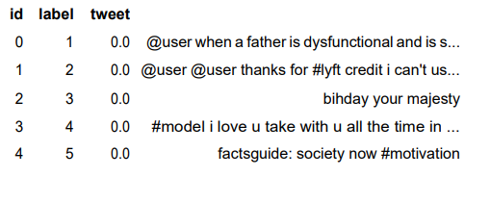
Datasets Collection

Slide 11
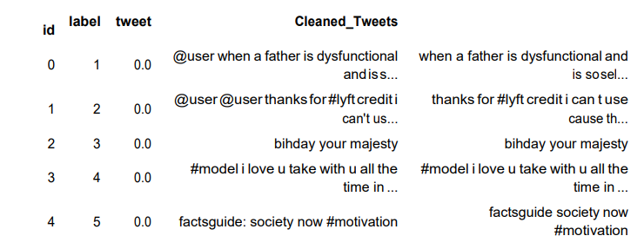
Data Cleaning

Slide 12
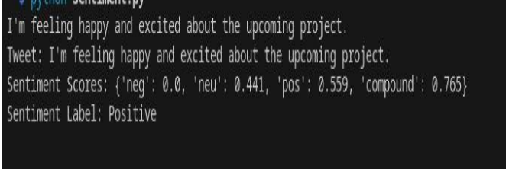
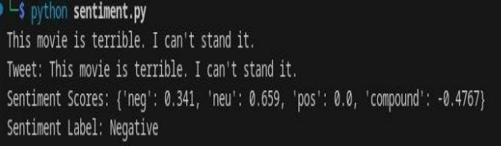
Model Training

Slide 13
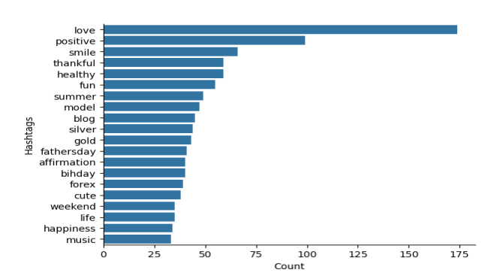
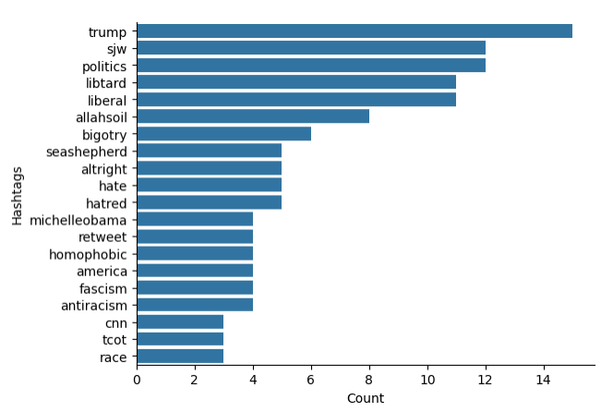
Graphical Representation

Slide 14
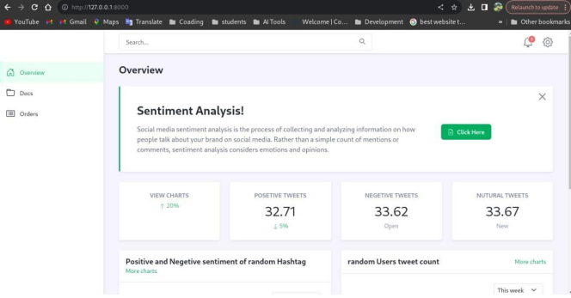
Dashboard

Slide 15
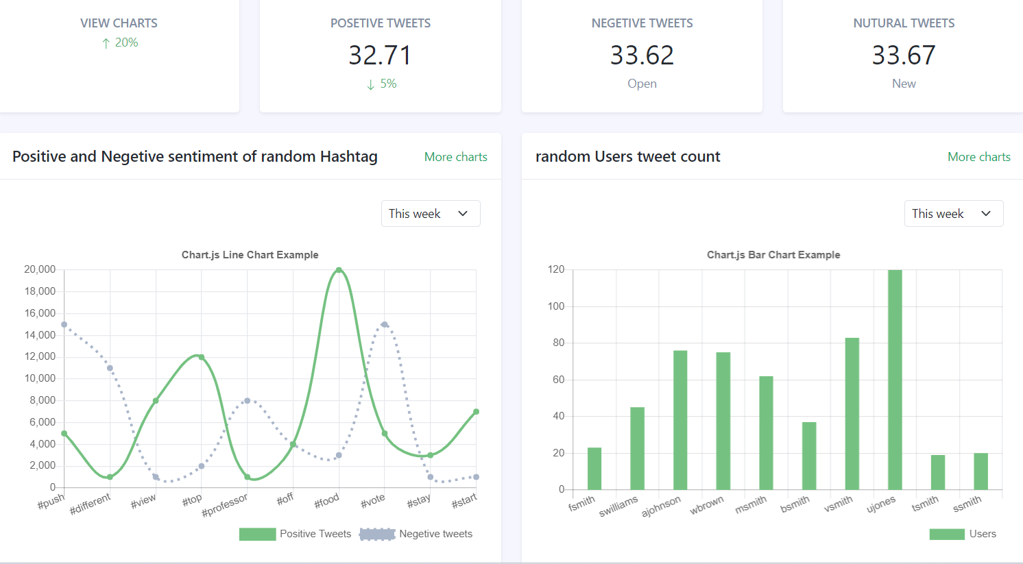
Web based graphical representation

Slide 16
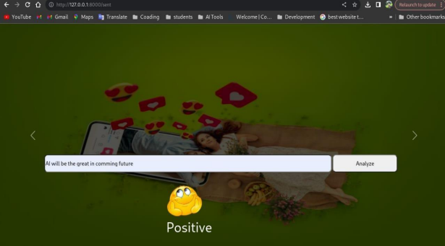
USER INTERFACE Single line analysis of positive output

Slide 17
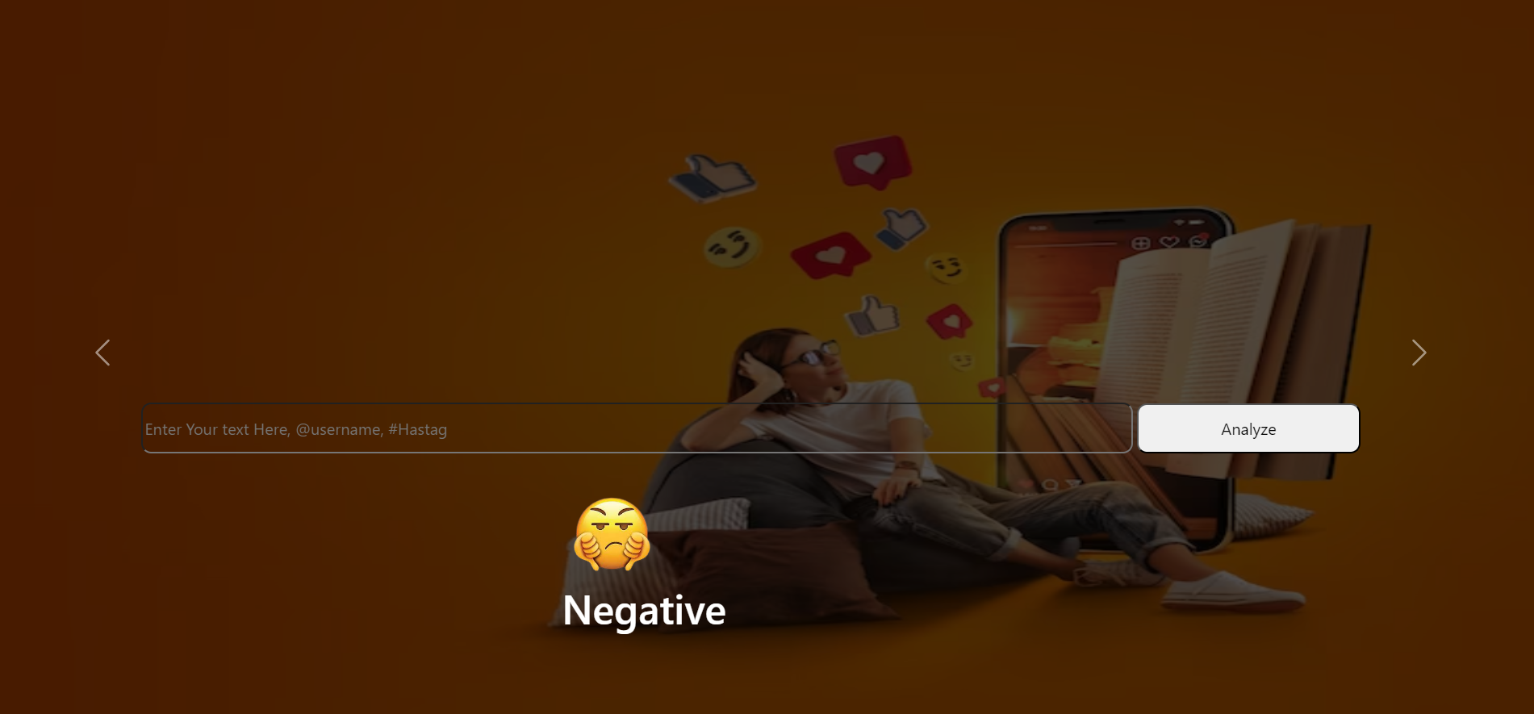
Negative output

Slide 18

Neutral output

Slide 19
Conclusion
In conclusion, the sentiment analysis project has successfully achieved its objectives of developing a robust sentiment analysis tool for processing social media content. The project focused on creating an accurate sentiment categorization model, implementing real-time analysis capabilities, adhering to ethical standards and data privacy protocols, and exploring Explainable AI (XAI) methods for model interpretability.
A user-friendly web interface was developed, allowing individuals and businesses to input social media content and receive instant sentiment analysis results. This real-time capability enhances the user experience and responsiveness of the tool.
The sentiment analysis tool developed in this project holds practical implications for individuals and businesses operating in the digital sphere. It serves as a valuable resource for monitoring and managing online presence, understanding public perception, and gauging customer feedback. The user-friendly interface, coupled with high accuracy and ethical considerations, positions the tool as a reliable asset in the realm of sentiment analysis.

Slide 20
References
[1] David Osimo and Francesco Mureddu, "Research challenge on Opinion Mining and Sentiment Analysis“
[2] Maura Conway, Lisa McInerney, Neil O’Hare, Alan F. Smeaton, Adam Berminghan, "Combining Social Network Analysis and Sentiment to Explore the Potential for Online Radicalisation," Centre for Sensor Web Technologies and School of Law and Government.
[3] Adobe® SocialAnalytics, powered by Omniture®.
[4] Brandwatch. [Online].http://www.brandwatch.com/
[5] Sentiment140.[Online]. http://www.sentiment140.com

